Slide 1



Microsoft Fabric
Sessão 6 Realizando análise de dados em tempo real
Armando Lacerda
Azure Cloud Architect Independent Consultant
Tiago Balabuch
Cloud Solutions Architect
Notes:
Both

Slide 2
Microsoft Fabric
Sessão 6 Realizando análise de dados em tempo real + Ciência de Dados
Armando Lacerda
Azure Cloud Architect Independent Consultant
Tiago Balabuch
Cloud Solutions Architect
Notes:
Both

Slide 3
Agenda
Apache Spark no Microsoft Fabric
Notebooks and Spark processing
Demos

Slide 4







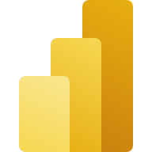
OneLake
Data Factory
Data Warehouse
Data Engineering
Data Science
Real Time Analytics
Data Activator
Power BI

Slide 5
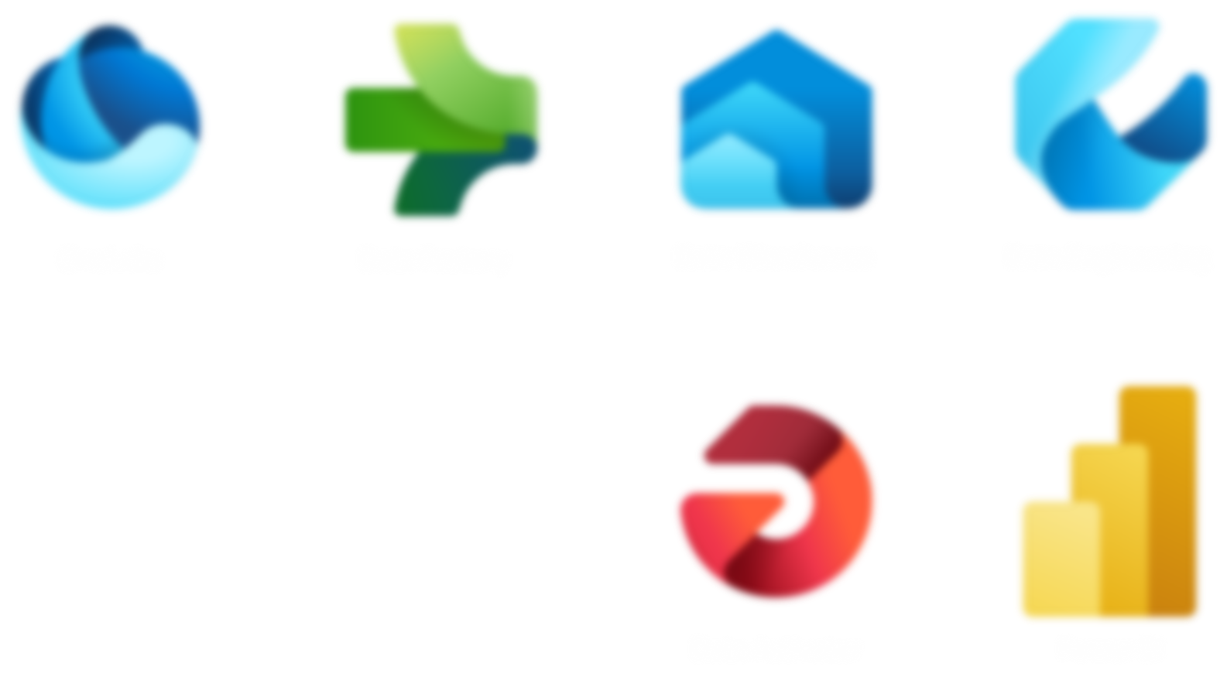
Data Science
Real Time Analytics

Slide 6




Data Engineer
Notebook

Slide 7

Data Engineer
Notebook
Lakehouse

Slide 8

Data Engineer
Notebook
Notebook
Notebook
Data Scientist
Lakehouse

Slide 9
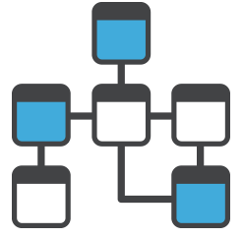
Data Engineer
Notebook
Notebook
Notebook
Data Scientist
Lakehouse

Slide 10
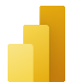

Data Engineer
Notebook
Notebook
Notebook
PowerBI
Data Scientist
Data Analyst
Lakehouse

Slide 11
Data Science
Data Discovery
Data Preparation
Experiments and Models
Enrich & Operationalize
Expose Insights

Slide 12



Data Science
Distributed ML Model Training
MLflow support
Cognitive Services
OpenAI LLMs

Slide 13
Demos

Slide 14

Real-time analytics
One Logical Copy
By-default streaming ingestion
By-default indexing everything
Time and Hash based data partitioning
Native support for structured, semi-structured and free text data
In-place transformation

Slide 15
Real-time analytics
Tightly integrated with Fabric experiences
Mirroring to Lakehouse
By-default integration with event streaming sources
By-default integration with Power BI

Slide 16
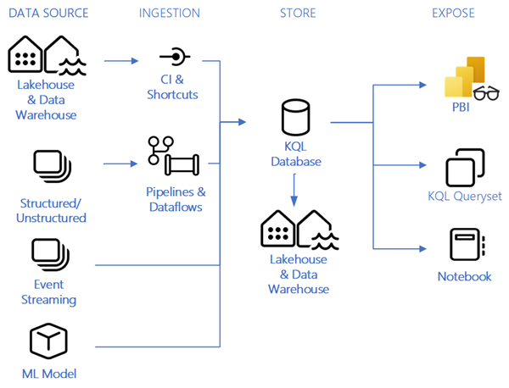
Real-time analytics

Slide 17
Demos

Slide 18
Nos vemos na próxima sessão.
Armando Lacerda
Azure Cloud Architect Independent Consultant
Tiago Balabuch
Cloud Solutions Architect
Notes:
Armando and Tiago

